Slide 1
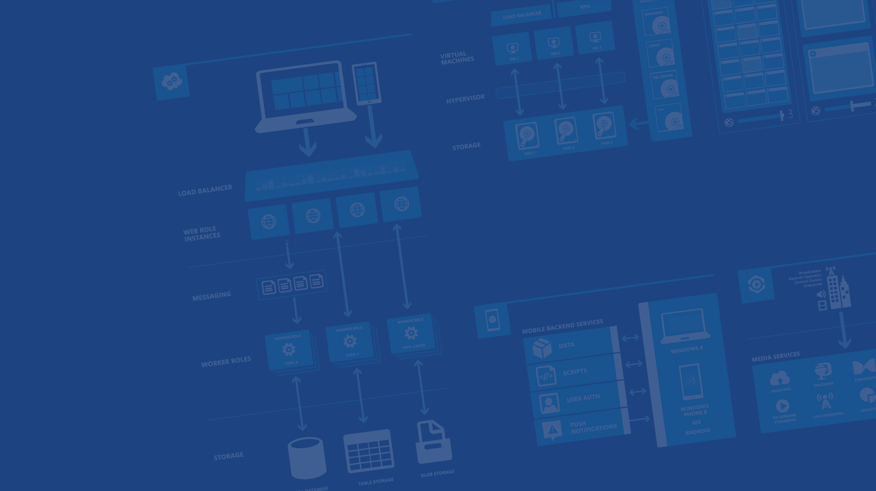
Polyglot Persistence in Microsoft Azure
Presenter Name
Charalampos Karypidis
Lead Developer – DevOps
@xabikos
Microsoft Azure

Slide 2
Agenda
Blobs
Redis Cache
Tables
SQL Databases
Queues
DocumentDB

Slide 3


Microsoft Azure Data Services
SQL Server in a VM
SQL Database
DocumentDB
Tables
Blobs
fully managed, scalable, queryable, schemafree JSON document database service for modern applications
fully featured RDBMS
transactional processing
rich query
managed as a service
elastic scale
schema-free data model
internet accessible http/rest
arbitrary data formats

Slide 4
Microsoft Azure Storage Blob

Slide 5
Two Types of Blobs Under the Hood
Block Blob
Page Blob
Notes:
Slide Objective
Understand that there are two blob types

Slide 6
Microsoft Azure Storage Table

Slide 7
Table Storage Concepts
Account
Table
Entity
Name =…
Email = …
customers
Name =…
EMailAdd=
contoso
Photo ID =…
Date =…
photos
Photo ID =…
Date =…
Notes:
Slide Objectives
Understand Tables
Speaker Notes
The Table service provides structured storage in the form of tables.
The Table service supports a REST API that is compliant with the ADO.NET Data Services REST API.
Developers may also use the .NET Client Library for ADO.NET Data Services to access the Table service.
Notes
http://msdn.microsoft.com/en-us/library/dd573356.aspx

Slide 8
Table Storage Details
Not an RDBMS Table!
The mental picture is ‘Entities’
Notes:
Slide Objectives
Understand Tables
Speaker Notes
Within a storage account, a developer may create named tables.
Tables store data as entities.
An entity is a collection of named properties and their values, similar to a row.
Tables are partitioned to support load balancing across storage nodes.
Each table has as its first property a partition key that specifies the partition an entity belongs to.
The second property is a row key that identifies an entity within a given partition.
The combination of the partition key and the row key forms a primary key that identifies each entity uniquely within the table.
The Table service does not enforce any schema.
A developer may choose to implement and enforce a schema on the client side
Notes
http://msdn.microsoft.com/en-us/library/dd573356.aspx

Slide 9
Table Storage Details
Entity can have up to 255 properties
Up to 1MB per entity
Notes:
Slide Objectives
Understand Tables and Entities
Speaker Notes
Tables store data as entities.
An entity is a collection of named properties and their values, similar to a row- not an RDBMS though
Tables are partitioned to support load balancing across storage nodes.
Each table has as its first property a partition key that specifies the partition an entity belongs to.
The second property is a row key that identifies an entity within a given partition.
The combination of the partition key and the row key forms a primary key that identifies each entity uniquely within the table.
The Table service does not enforce any schema.
A developer may choose to implement and enforce a schema on the client side
Notes
http://msdn.microsoft.com/en-us/library/dd573356.aspx
http://msdn.microsoft.com/en-us/library/dd179338.aspx

Slide 10
Table Storage Details – Entity Properties
PartitionKey & RowKey are mandatory properties
Composite key which uniquely identifies an entity
They are the only indexed properties
Defines the sort order
Notes:
Slide Objectives
Understand Tables and Entities
Speaker Notes
Tables store data as entities.
An entity is a collection of named properties and their values, similar to a row- not an RDBMS though
Tables are partitioned to support load balancing across storage nodes.
Each table has as its first property a partition key that specifies the partition an entity belongs to.
The second property is a row key that identifies an entity within a given partition.
The combination of the partition key and the row key forms a primary key that identifies each entity uniquely within the table.
The Table service does not enforce any schema.
A developer may choose to implement and enforce a schema on the client side
Notes
http://msdn.microsoft.com/en-us/library/dd573356.aspx
http://msdn.microsoft.com/en-us/library/dd179338.aspx

Slide 11
Microsoft Azure Storage Queue

Slide 12
Queue-based Load Levelling Pattern
Producers
Consumers
P₁
C₁
Queue
4
3
2
1
P₂
C₂

Slide 13
Microsoft Azure SQL Database

Slide 14
A Server is not a machine
SQL Server
Machine
(Physical/VM)
Azure
SQL Database Server
TDS Endpoint
Notes:
Slide Objectives:
Understand that while there are physical SQL Server boxes behind the scenes, when connecting to SQL Database, you are not connecting to a physical server, but to a TDS endpoint.
Transition:
The key to understanding SQL Database is understanding while SQL Database is SQL Server, we do not interact with them in the same physical manner.
Speaking Points:
In an on-premises environment, we typically have physical access to the actual SQL Server server.
In Microsoft Azure, we do not have physical access to the actual server.
Notes:
It is important that the attendee understands that it IS INDEED SQL Server at the platform layer. There are physical boxes running SQL Server 2012 Enterprise Edition. However, due to the nature of the Azure environment to provide the high-availability and scalability necessary, access to the physical boxes is currently not supported.

Slide 15
Scale out with ElasticScale
Built-in regional database replicas for additional protection
Uptime SLA of 99.99%
SQL Database – The Basics
Notes:
Slide Objectives:
Understand the overall concepts and benefits of SQL Database
Transition:
Let’s clear up any confusion and look at the basics of what SQL Database really is and some of its benefits.
Speaking Points:
The same great SQL Server database technology that you know, love, and use on-premises provided as a service
Enterprise-ready
Automatic support for High-Availability
Designed to scale on-demand to provide the same great elasticity
Notes:
High-availability – 3 copies of the database free for the cost of the one database. Always in sync. The cost to do this on-premises isn’t cheap. This is FREE in SQL Database.

Slide 16

Redis Cache

Slide 17
Document DB

Slide 18
Fully managed, scalable JSON document database service

